Slide 1
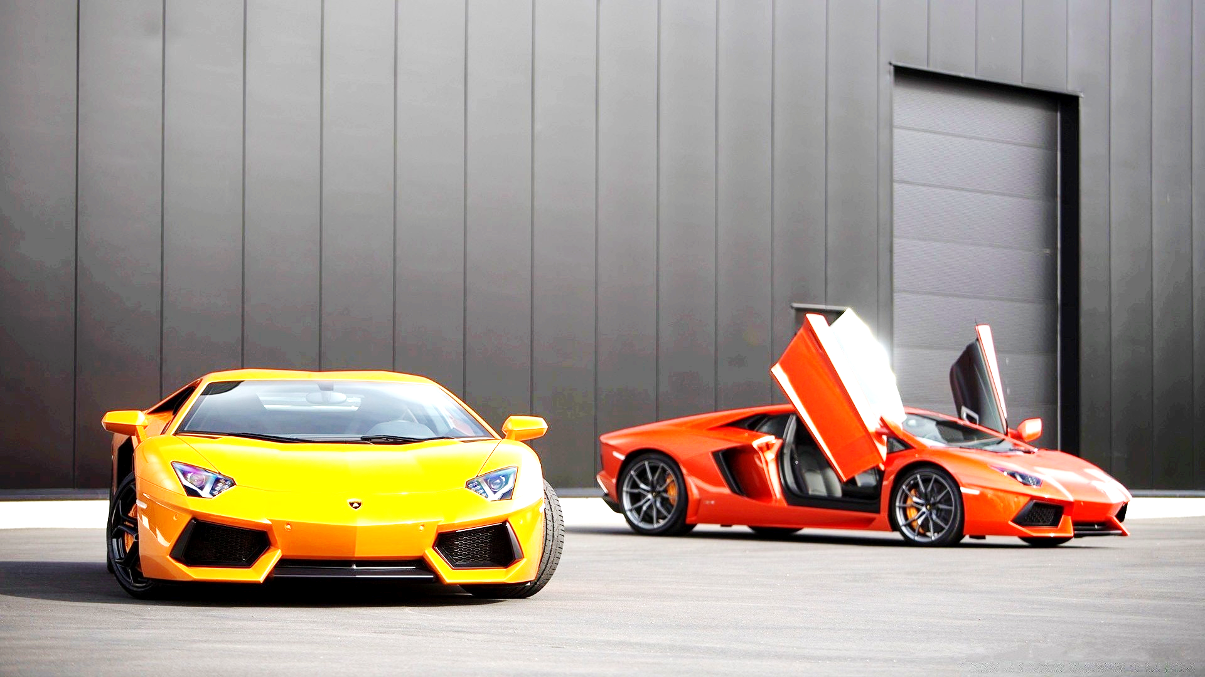
Luxury Cars Dealer
| Data Analysis |

Slide 2
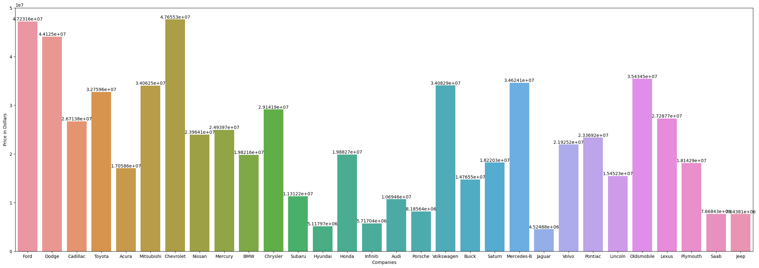
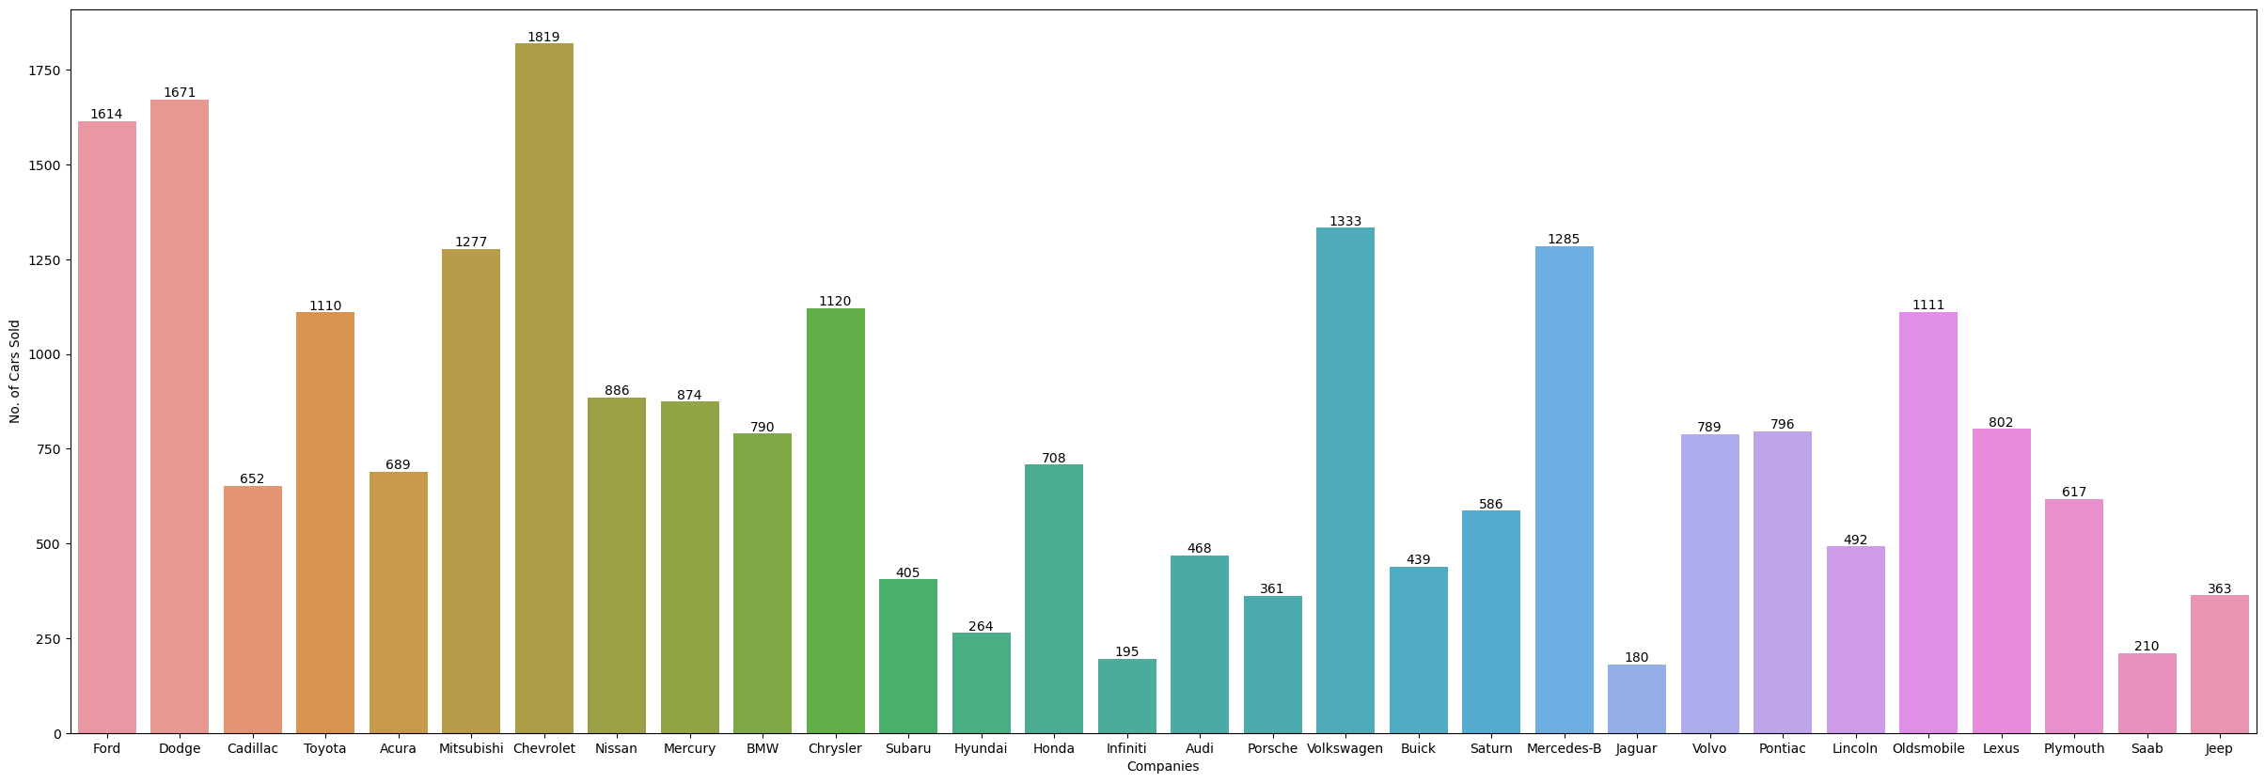
Conclusion
Chevrolet, Ford, Dodge and Oldsmobile are most Revenue generating companies
Where as Volkswagen is most selling car company

Slide 3
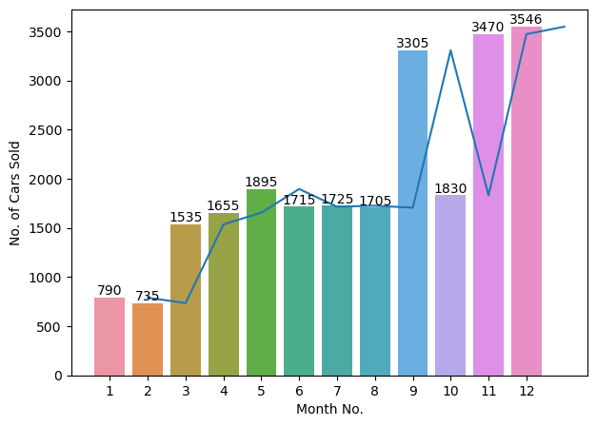
Conclusion
September, November and December are most profiting Months

Slide 4
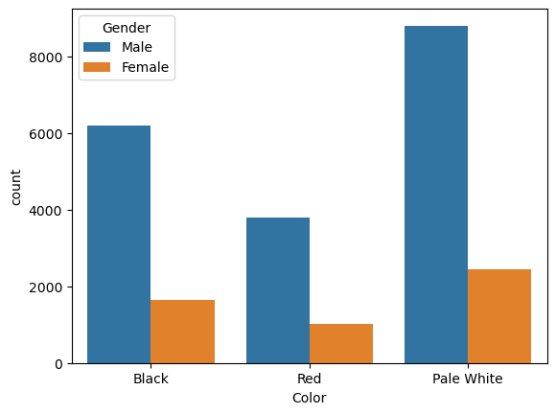
Conclusion
More people are choosing white cars over the Red and Black

Slide 5
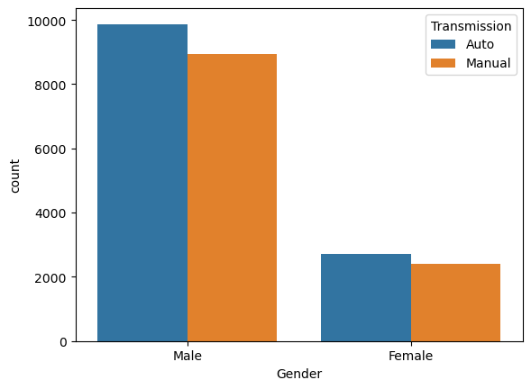
Conclusion
Males are purchasing more cars rather than Female

Slide 6
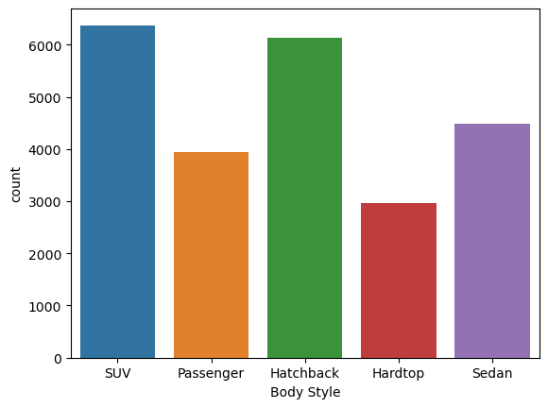
Conclusion
SUV and Hatchback are getting sold as rather than other

Slide 7
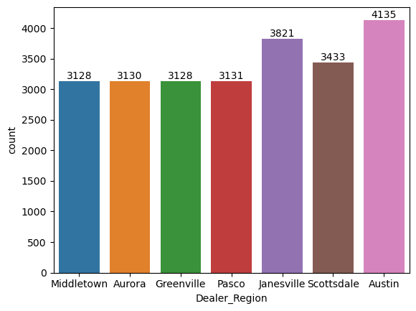
Conclusion
Dealer in the Austin and Janesville region are selling more vehicles and generating more revenue

Slide 8
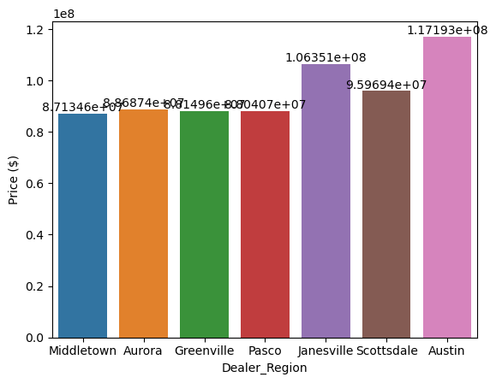
Conclusion
Dealer in the Austin and Janesville region are selling more vehicles and generating more revenue

Slide 9
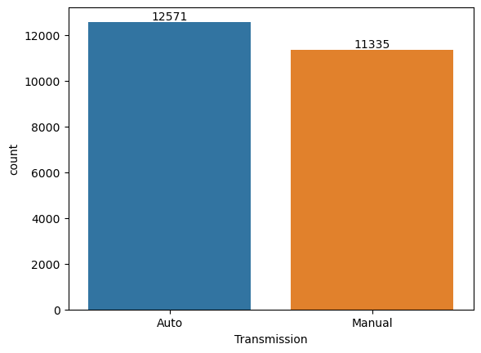
Conclusion
Automated gear vehicle are more preferable

Slide 10
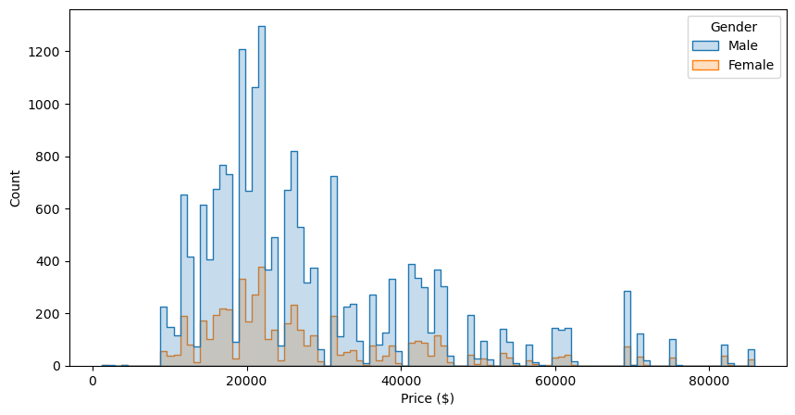
Conclusion
Cars with the price range of 10k Dollar to 25k Dollar are getting sell more

Slide 11
Final-Conclusion
Male with Annual income within ($13500) will buy the Most affordable car within the price range of (18000-22000).
There are more chances that customer could buy the white car with automated gear system in the month of either September/November or December.

